Slide 1

G-Chat
G-Chat is a rule-based chatbot developed for Gateway Group of Companies

Slide 2
About

Slide 3
G-chat has been developed to replace a sales-person for Gateway Group of Companies.
It is a rule-based chatbot. A user can interact with it by selecting the appropriate options, given after each question.
Upon receiving an invalid input option it will throw a error message.
It is smart, fast and easy to interact with.

Slide 4
Technical Specifications.

Slide 5
Technical Specifications:
Technologies used:
FrontEnd:
HTML
CSS
Javascript
BackEnd:
Python
Flask
SQLAlchemy
Jinja

Slide 6
Running G-Chat on your system

Slide 7
How to run G-Chat on your local machine
Clone Repository:
> git clone https://github.com/kajal241199/F-gchat
Navigate to the working directory:
> cd G-Chat_Final-main
Install the virtual environment
> python -m pip install --user virtualenv
python -m virtualenv --help

Slide 8
Activate the virtual environment:
> env\Scripts\activate
Install the dependencies
> pip install -r requirement.txt
Run the code at your local envn
>python app.p
>Open your browser and the site can be found running at http://127.0.0.1:5000/

Slide 9
Working of G-Chat

Slide 10
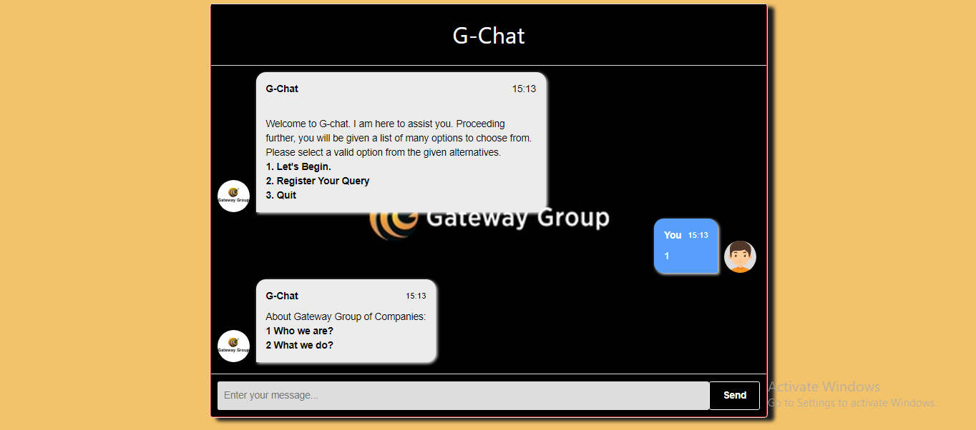
Home Screen - End User

Slide 11
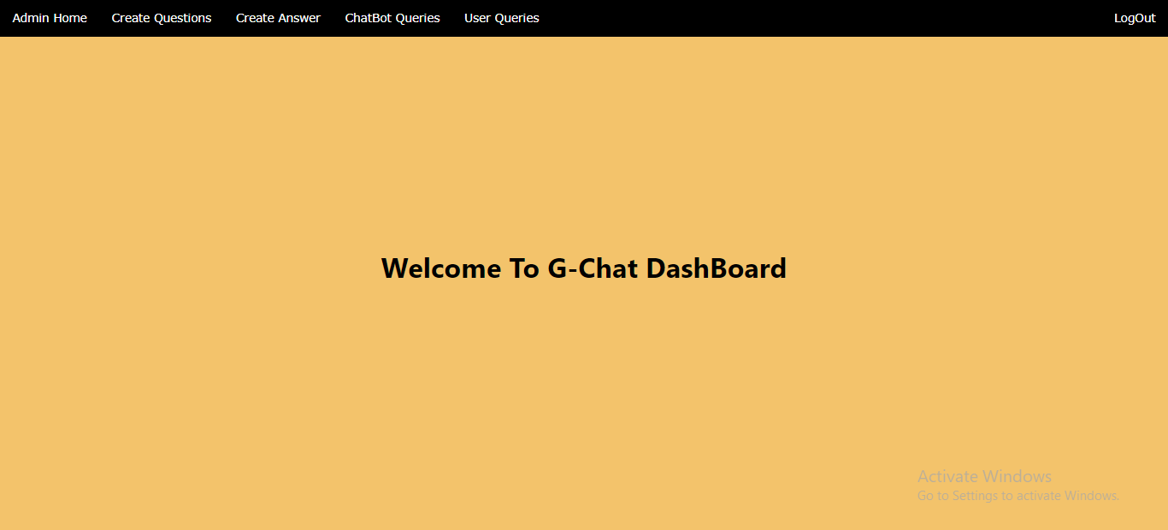
Home Screen - Admin Login

Slide 12
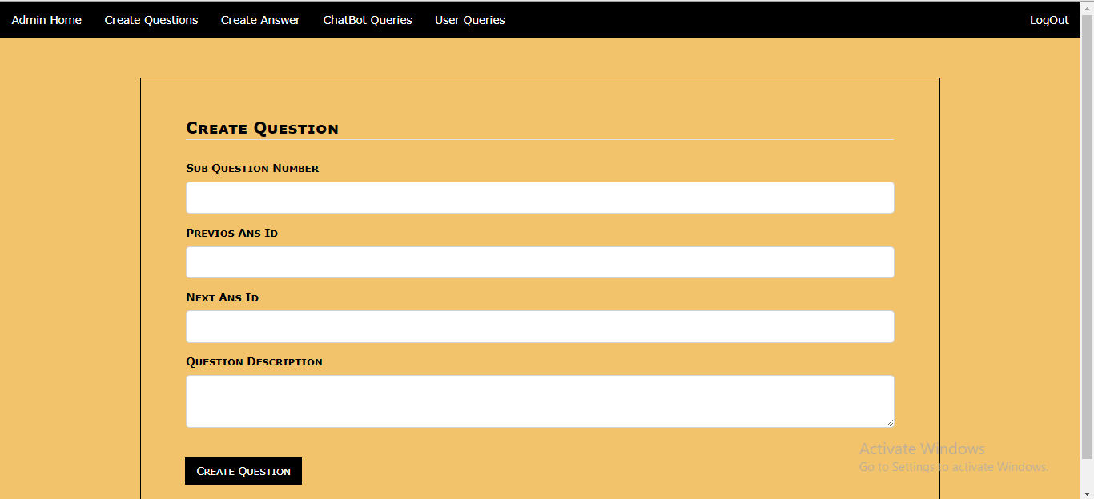
Here, admin can create new question that will be asked by G-Chat

Slide 13
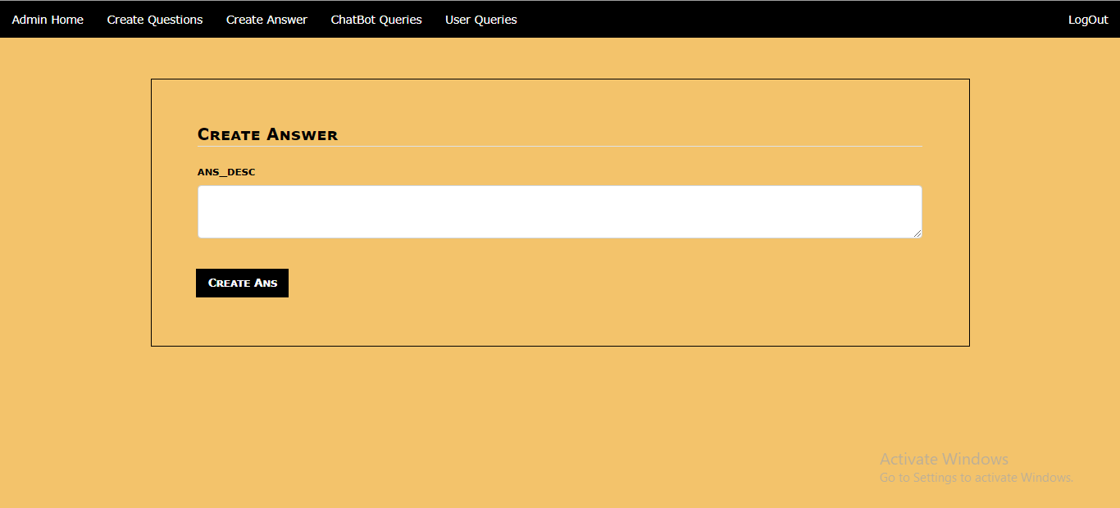
Here, answers to questions can be created

Slide 14
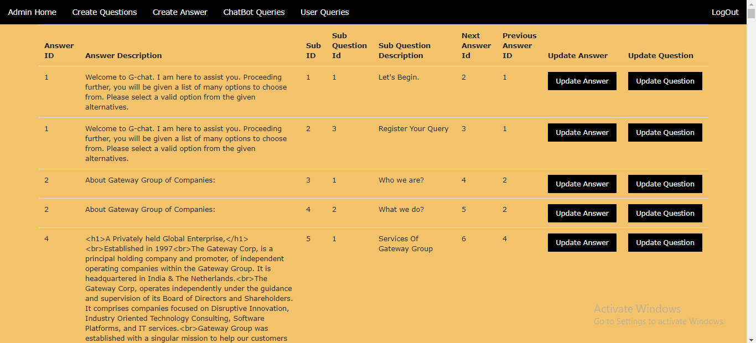
This page displays all the questions and answer in GChat database

Slide 15
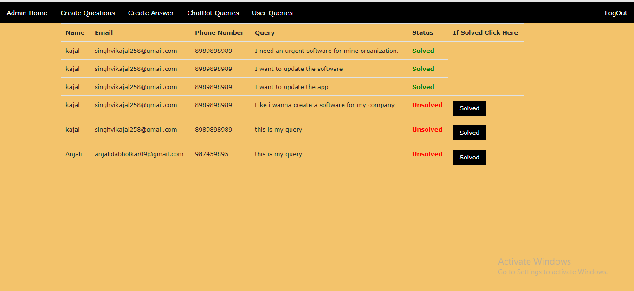
Here, admin can see all the quotations and queries given by customers.

Slide 16
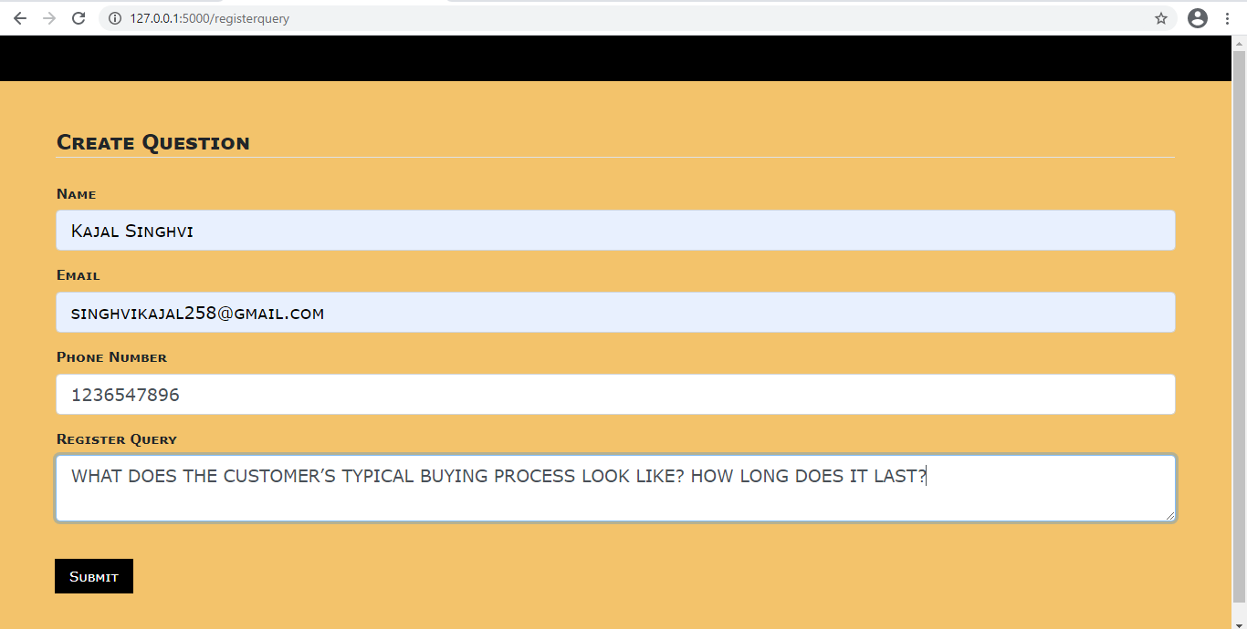
Register query

Slide 17
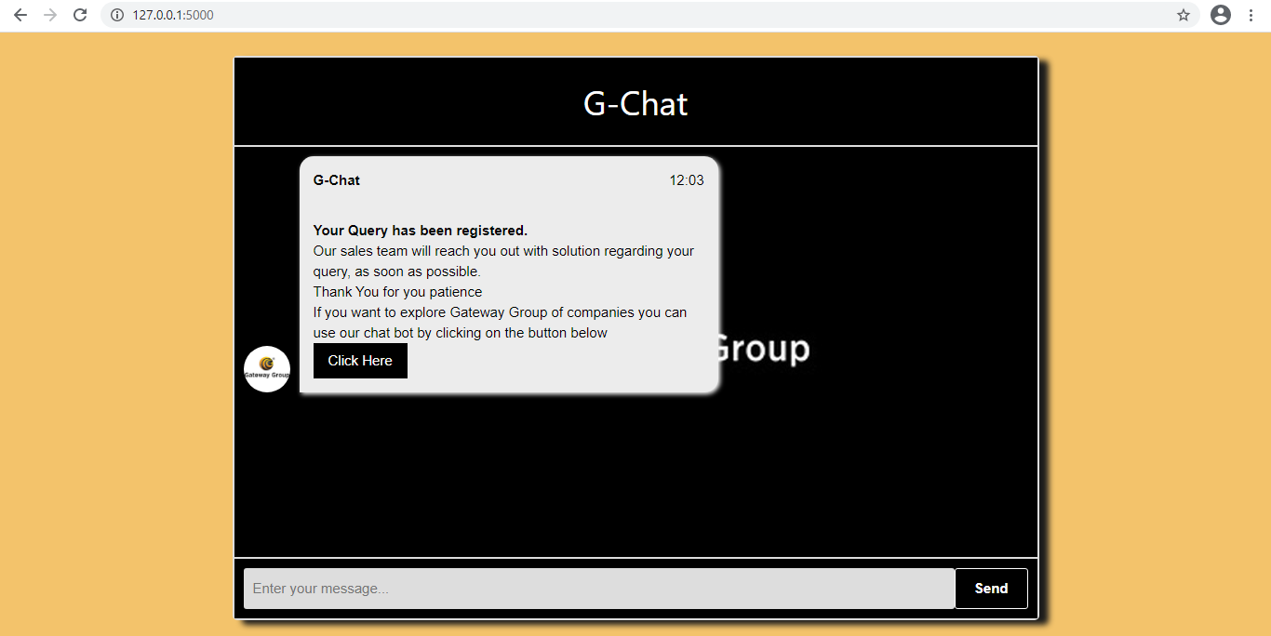
Upon successful query\quotation registration

Slide 18
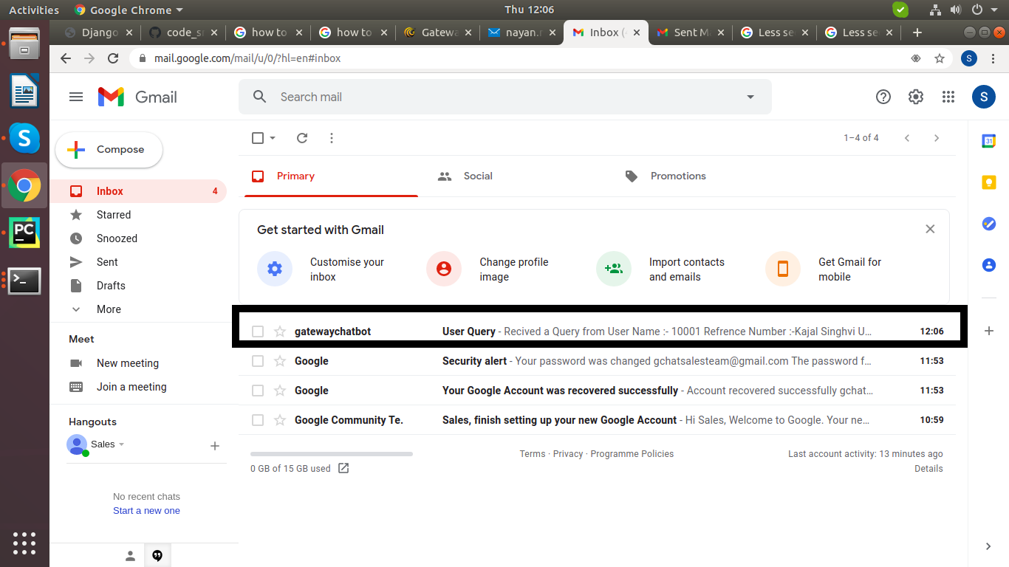
Email received by sales team whenever a query is registered (1)

Slide 19
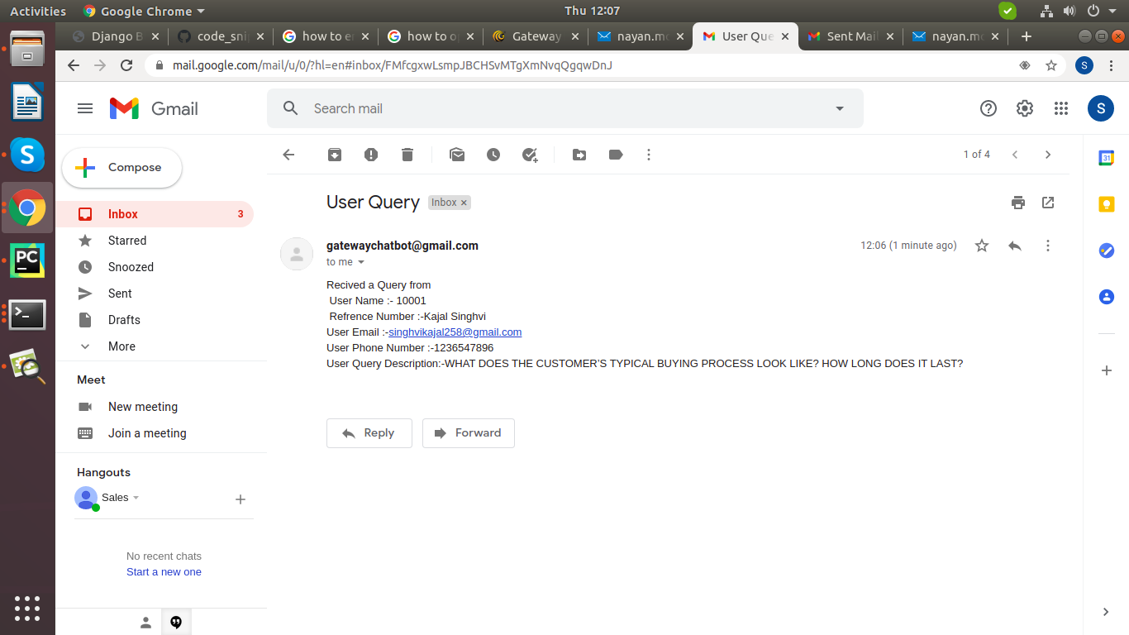
Email received by sales team whenever a query is registered (2)

Slide 20
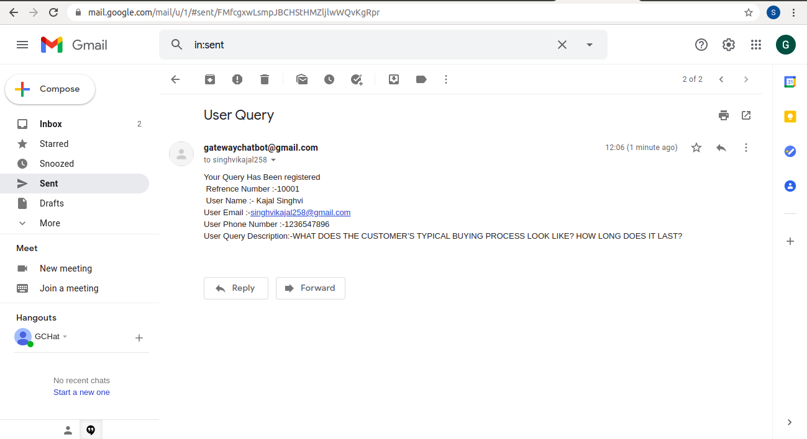
Receipt/Copy sent to customer upon successful registration of query

Slide 21
THANK YOU!

